Slide 1


Social Buzz’s Content Categories Analysis

Slide 2


Today’s Agenda:
Project recap
Problem
The Analytics Team
Process
Insights
Summary

Slide 3

Social Buzz is experiencing rapid growth in terms of number of users and available data. To help manage this huge scale, Accenture has embarked on a 3-month pilot with Social Buzz to:
• Carry out an audit of their big data practice
• Proffer recommendations to ensure success of the forthcoming IPO
• Carry out an analysis of Social Buzz’s content categories in order to highlight the top 5 categories with the largest aggregate popularity
Project Recap

Slide 4




Problem
Due to the rapid growth and digital nature of Social Buzz’s core product, the amount of data that they create, collect and must analyze is huge.
Every day over 100,000 pieces of content, ranging from text, images, videos and GIFs are posted. All of these constitute highly unstructured data that requires expertise in handling.
Social Buzz’s biggest challenge is how to capitalize on this data to gain a deeper understanding of its audience and therefore provide a more personalized and enjoyable experience.

Slide 5




Andrew Fleming
Chief Technology Architect
The Analytics team
Marcus Rompton
Senior Principal
Om Kadam
Data Analyst

Slide 6

Process
1
Data Understanding
2
Data Extraction and Cleaning
3
Data Modelling
4
Data Analysis
5
Uncover Insights and Recommendations

Slide 7

Insights
Photo
6589
25.4%
animals
1897
7.72%
heart
1622
6.6%
Highest Count for Content Type
Highest Count for Category Type
Highest Count for Reaction Type

Slide 8
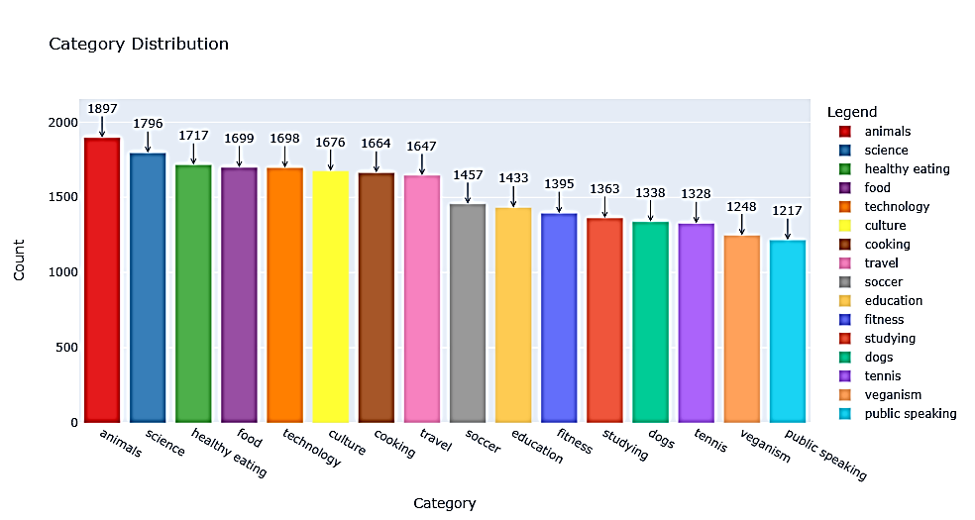
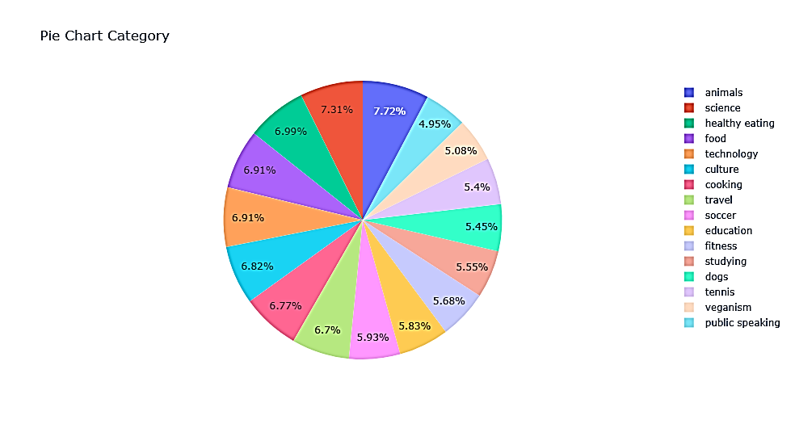
According to our analysis, the top 5 content categories are Animals, Science, Health Eating, Food, and Technology in descending order.

Slide 9
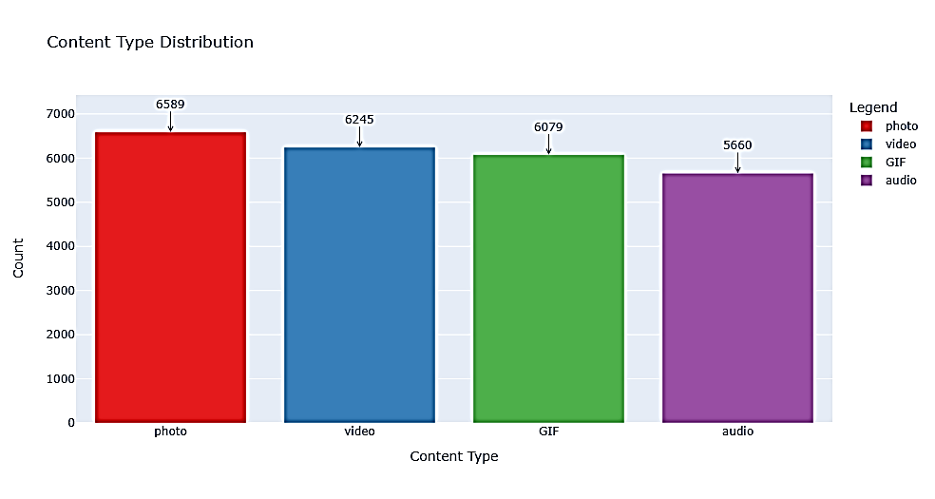
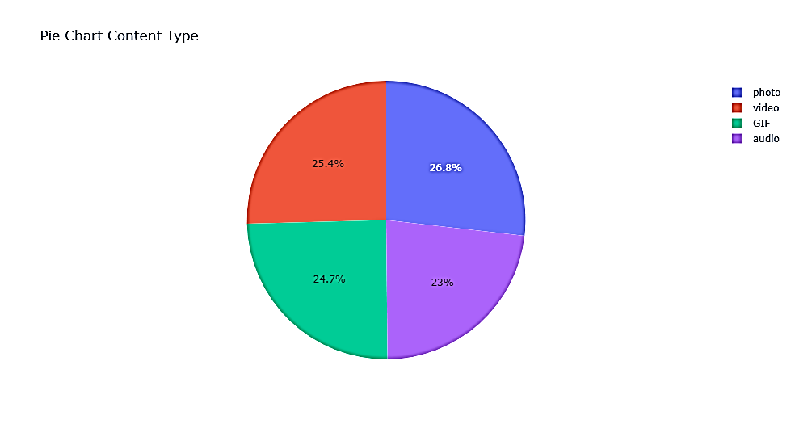
According to our analysis, the most reacted content type is photo followed by videos which is in turn followed by GIF and then audio

Slide 10

ANALYSIS
Animals and Science are the two most popular content categories indicating an innate tendency to seek connections with nature and facts
INSIGHT
Healthy eating and food fall in the top 5 category with healthy eating outperforming food by 0.76%. This is a broad indication of an audience within Social Buzz’s user base. Creating campaigns, working with influencers and brands that support healthy eating and healthy lifestyle can help to boost growth in these 2 categories.
NEXT STEPS
Social Buzz can leverage holiday seasons to boost growth and user engagement with the food content category via relevant social media strategies.
Summary

Slide 11
Thank you!
ANY QUESTIONS?

